Slide 1
Collaboration-Based Design
Prof. Dr. Dirk Riehle
Friedrich-Alexander University Erlangen-Nürnberg
ADAP C11
Licensed under CC BY 4.0 International
Notes:
It is Friedrich-Alexander University Erlangen-Nürnberg – FAU, in short.
Corporate identity wants us to say “Friedrich-Alexander University”.

Slide 2
Collaboration-based Design
Collaboration-based design
  An approach to modeling and implementation using collaborations
Collaboration (specification / description) a.k.a. role model
  A model of objects collaborating for one particular purpose
Role (type / specification / description)
  A model of the behavior of one object within a collaboration
Collaboration (instance)
  A set of specific objects collaborating according to a collaboration specification
Object
  The representation of a phenomenon playing roles in collaborations

Slide 3
Benefits of Collaboration-based Design
Separation of Concerns
Better Reusable Models

Slide 4
File System Example Revisited

Slide 5
Primary Service Collaborations

Slide 6
Primary Service Roles as Code
public class Node {
// Client-Node-Collaboration
public String getName();
public void setName(String name);
...
}
public class Link extends Node {
// Client-Link-Collaboration
public Node getTarget();
...
}
public class File extends Node {
// Client-File-Collaboration
public void write(byte[] data);
...
}

Slide 7
Hierarchy Collaboration

Slide 8
Secondary Service Roles as Code
public class Node {
// Hierarchy-Collaboration
public Node getOwner();
public void setOwner(Node n);
// Other collaborations
...
}
public class Directory extends Node {
// Hierarchy-Collaboration
public void addOwned(Node n);
public void removeOwned(Node n);
public Iterater getIterator();
// Other collaborations
...
}

Slide 9
Parent Child Collaboration

Slide 10
Maintenance Roles as Code
public class Node {
// Parent-Child-Collaboration
protected Node getParent();
protected void setParent(Node n);
// Other collaborations
...
}
public class Directory extends Node {
// Parent-Child-Collaboration
// No methods
// Other collaborations
...
}

Slide 11
Types of Collaborations
Primary service collaborations
  Typically, client-service-collaborations
  The client role often has no methods
  Visible to the outside (of the model)
Secondary service collaborations
  Client-service-collaborations used for technical purposes
  Often follow design patterns to realize logic
  Visible to the outside (of the model)
Maintenance collaborations
  Collaborations that maintain the domain logic within the model
  Often follow design patterns to realize logic
  Usually not visible to the outside

Slide 12
Collaboration / Class Duality
A collaboration focuses on
  the interaction of objects for one purpose
A class focuses on
  the integration the roles an object plays in multiple collaborations

Slide 13
Collaborations and Role Binding to Classes

Slide 14
Collaboration-based Design and Reuse
For a collaboration to be used in multiple contexts
  It needs to be independent of those contexts
    Naming cannot be context-specific → Node becomes Owned
  It must be possible to apply it to those contexts
    Naming should be adjustable (method renaming) → Owned becomes Node
  Role composition (in one class) needs to be made explicit
    Composition has important domain analysis meaning
Reusable models need programming language support

Slide 15
Levels of Abstraction
 | Design Pattern | Design Template | Class Model
Level | Design illustration | Design template | Specific model
Language | No formal language available | UML-Collaboration | UML-Class-Model, UML-Collaboration-Use
Use in CBD | N/A | Collaboration | Role binding
Example | N/A | Hierarchy = { Client, Owner, Owned } ParentChild = { Parent, Child } | Hierarchy.Owner → Directory ParentChild.Parent → Directory

Slide 16
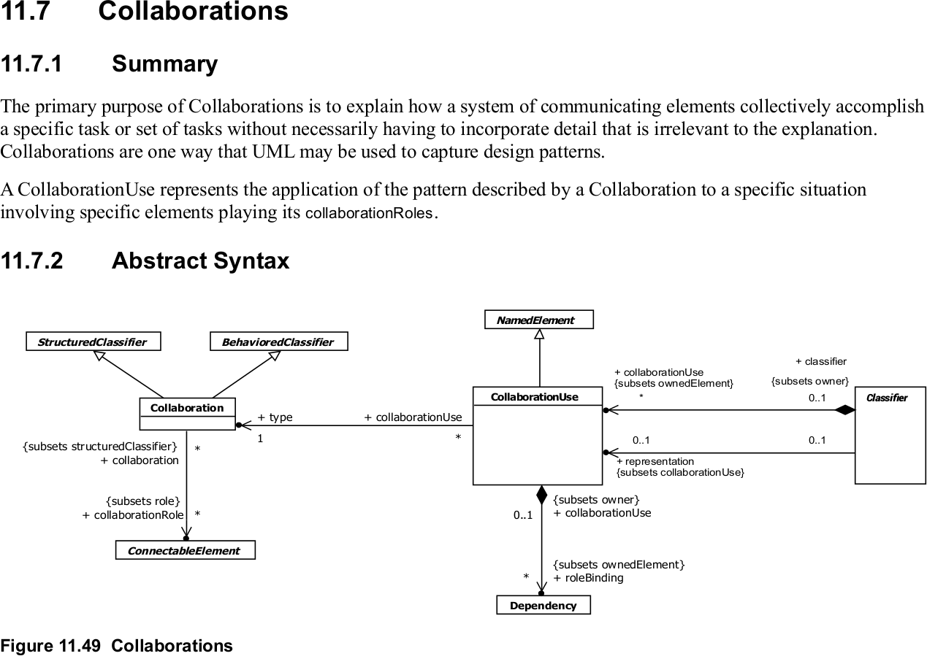
UML and Collaboration-based Design [1]
[1] From the UML 2.5 specification (May 2011)

Slide 17
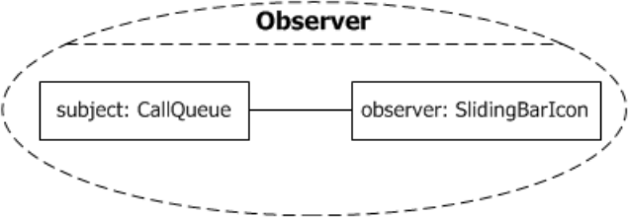
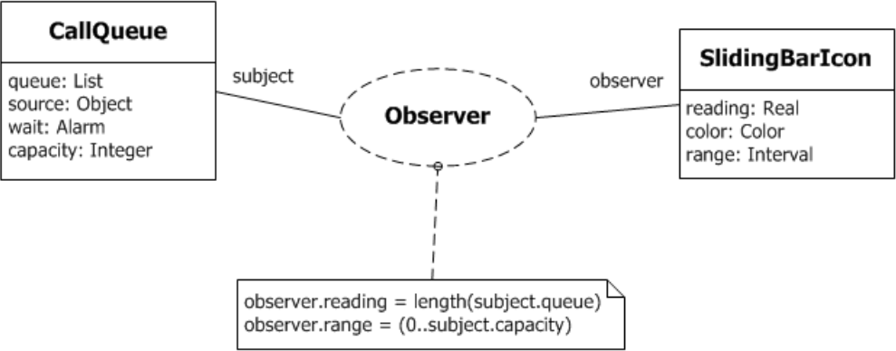
Concrete Syntax for Collaborations

Slide 18
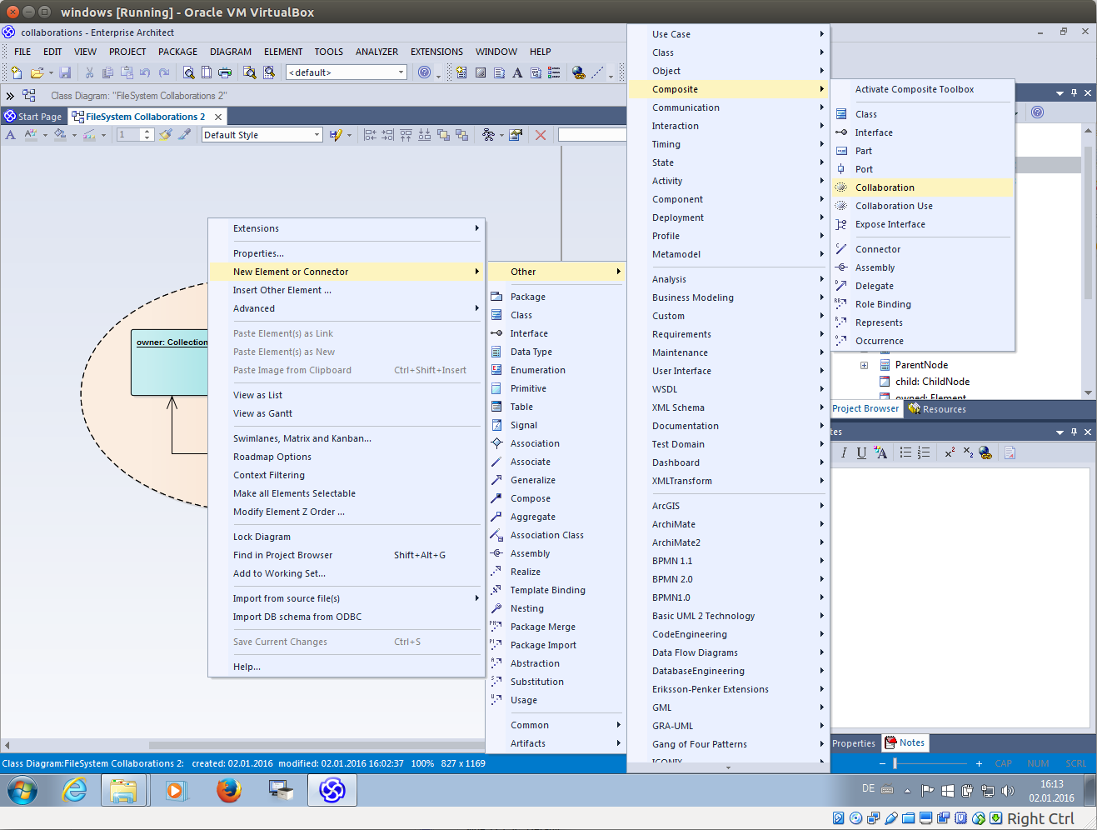

Slide 19
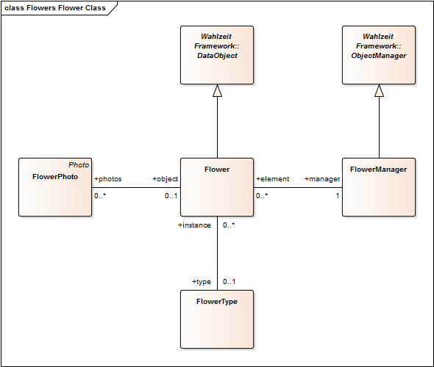

Slide 20
ObjectManager / Persistent
Collaboration
Flower / DataObject Collab.
Flower / FlowerType Collab.
FlowerPhoto / Flower
Collaboration
FlowerManager / Flower
Collaboration

Slide 21
Flower Collaborations
FlowerPhoto / Flower Collaboration
  Purpose: Provide main domain functionality
  Role types: FlowerPhoto (Client), Flower (Service)
Flower / FlowerType Collaboration (Type Object)
  Purpose: Provide information common to all instances of a type
  Role types: Client, Flower (Base Object), FlowerType (Type Object)
FlowerManager / Flower Collaboration (Manager)
  Purpose: Centralize object management in one place
  Role types: Client, FlowerManager (Manager), Flower (Element)

Slide 22
Lessons from the Flower Collaborations
Collaborations
  Often have an implicit Client role
  Almost always overlap when applied to a class model
  There should be inheritance between collaborations
  Many collaborations are design pattern applications

Slide 23
Collaborations in Programming [R00]
public collaboration ParentChild {
public role Parent {
public void addChild(Child c);
public void removeChild(Child c);
public Iterator<Child> getIterator();
}
public role Child { ... }
...
}
public class Node binds ParentChild.Child {
...
}
public class Directory extends Node binds ParentChild.Parent {
...
}

Slide 24
Roles as Code Templates [V97]
public interface Owner<C> {
public void addOwned(C c);
public void removeOwned(C c);
public Iterator<C> getIterator();
}
public class Node {
protected Node parent = null;
protected Node getParent() { ... }
protected void setParent(Node n) { ... }
...
}
public class Directory extends Node, implements Owner<Node> {
public void addOwned(Node n);
public void removeOwned(Node n);
public Iterator<Node> getIterator();
...
}

Slide 25
Client-side Role Specifcations
public collaboration File {
public role Client {
// no methods, but specification of
// behavioral constraints, e.g.
// no read or write before open or after close
}
public role File {
public void open();
public byte[] read(int);
public void write(byte[]);
public void close();
...
}
}

Slide 26
Similar / Related to Roles
Interfaces
Protocols
Mix-ins
Traits

Slide 27

Composite Pattern Revisited [G+95]

Slide 28
Participants Section of Composite Pattern
Component (Graphic)
  declares the interface for objects in the composition.
  implements default behavior for the interface common to all classes, as appropriate.
  declares an interface for accessing and managing its child components.
  (optional) defines an interface for accessing a component's parent in the recursive structure, and implements it if that's appropriate.
Leaf (Rectangle, Line, Text, etc.)
  represents leaf objects in the composition. A leaf has no children.
  defines behavior for primitive objects in the composition.
Composite (Picture)
  defines behavior for components having children.
  stores child components.
  implements child-related operations in the Component interface.
Client
  manipulates objects in the composition through the Component interface.

Slide 29
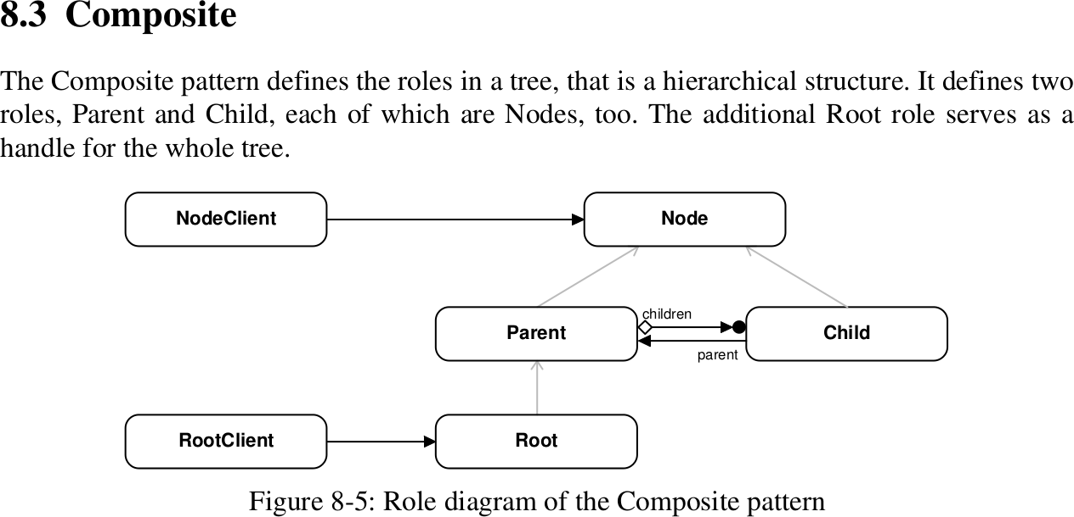
Composite Pattern as Role Model [R97]

Slide 30
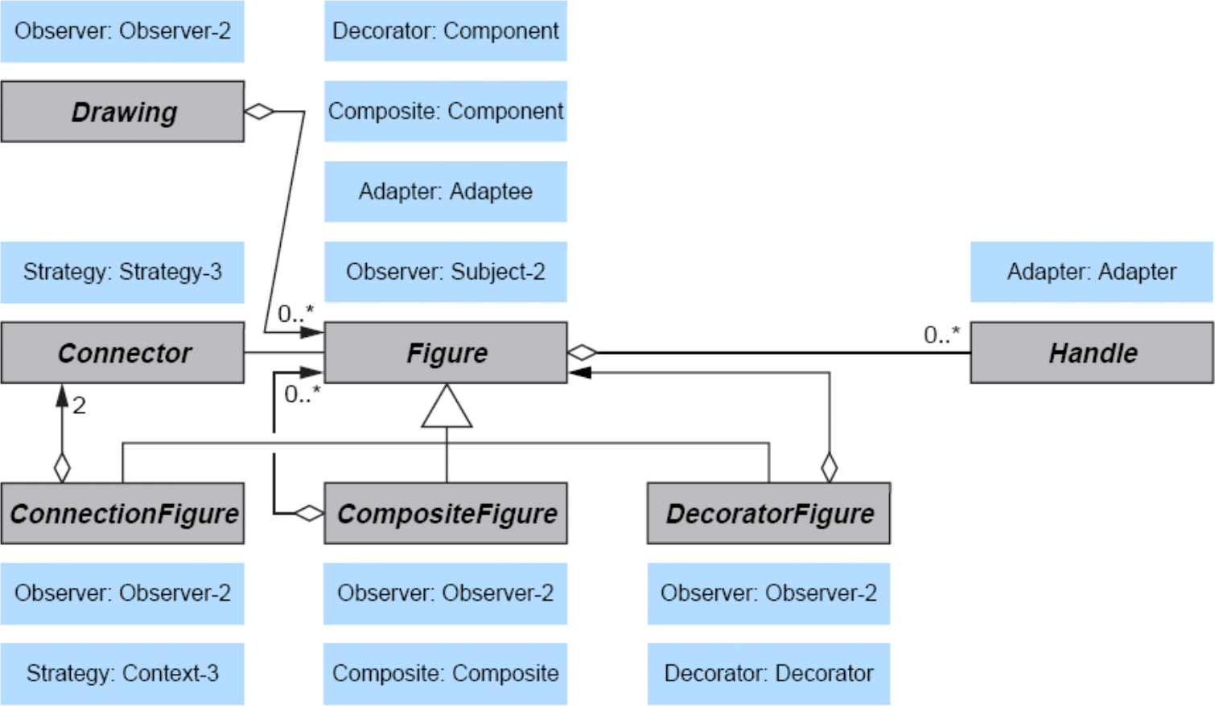
Design Pattern Composition [R11]

Slide 31
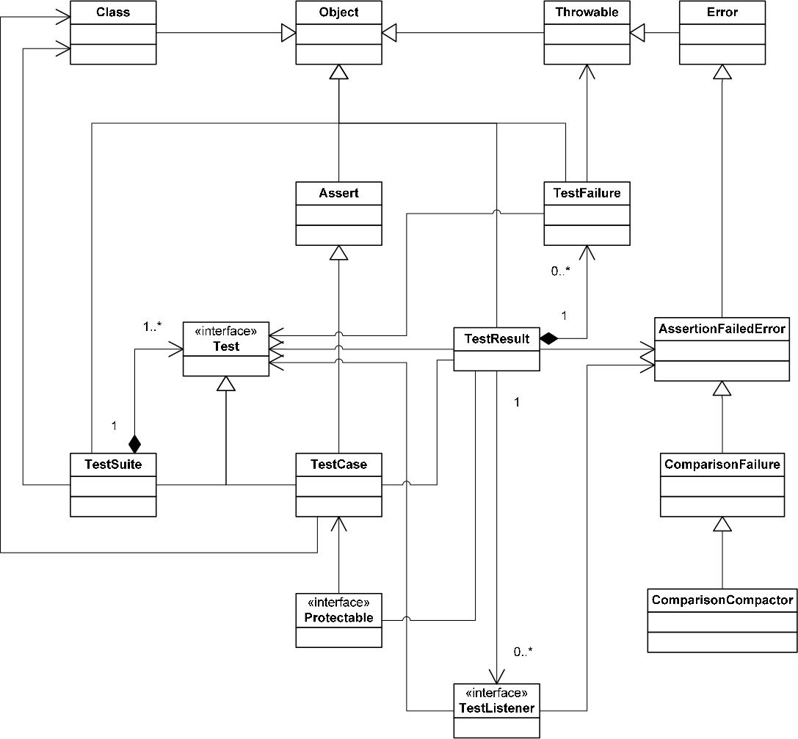
JUnit Design Patterns Applied

Slide 32
Review / Summary of Session
Collaboration-based design
  Definitions, constituents
  In design and programming
Design patterns, templates, models
Composition of models

Slide 33
Thanks! Questions?
dirk.riehle@fau.de – http://osr.cs.fau.de
dirk@riehle.org – http://dirkriehle.com – @dirkriehle
DR

Slide 34
Credits and License
Original version
  © 2012-2018 Dirk Riehle, some rights reserved
  Licensed under a Creative Commons Attribution 4.0 International License
Contributions
  ...

